Slide 1
Recent Results Using Faster Model
Stephen Henrich
8/1/2023

Slide 2
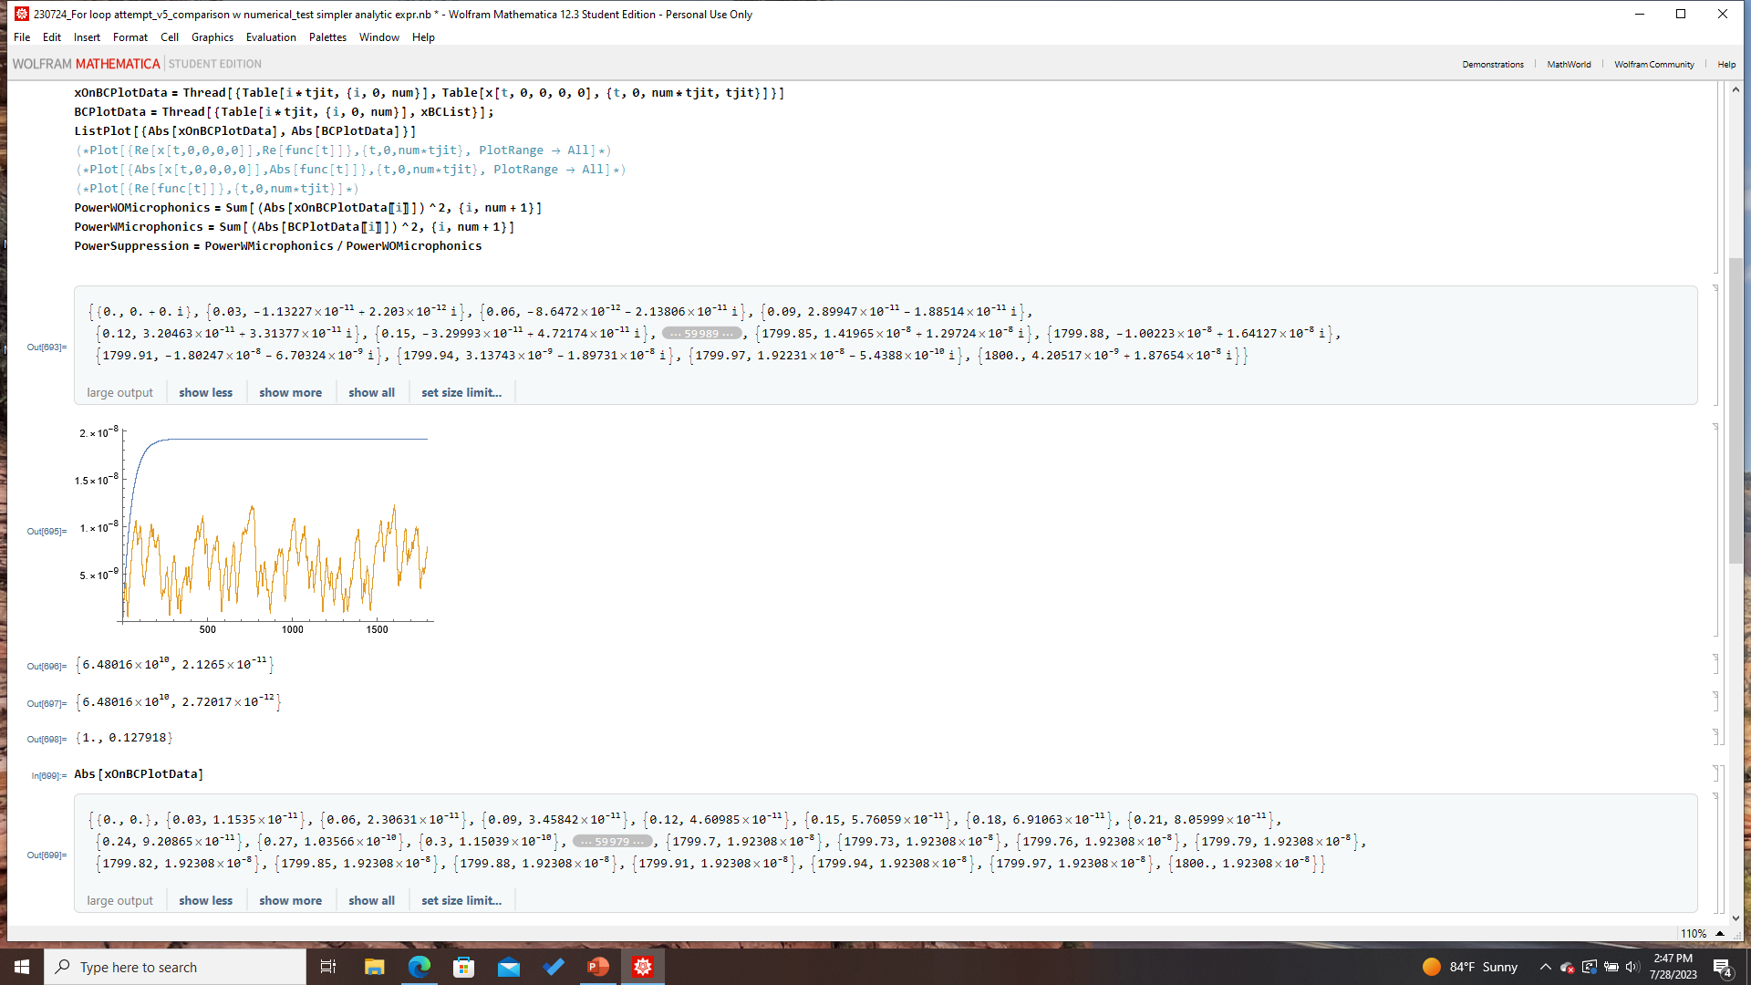
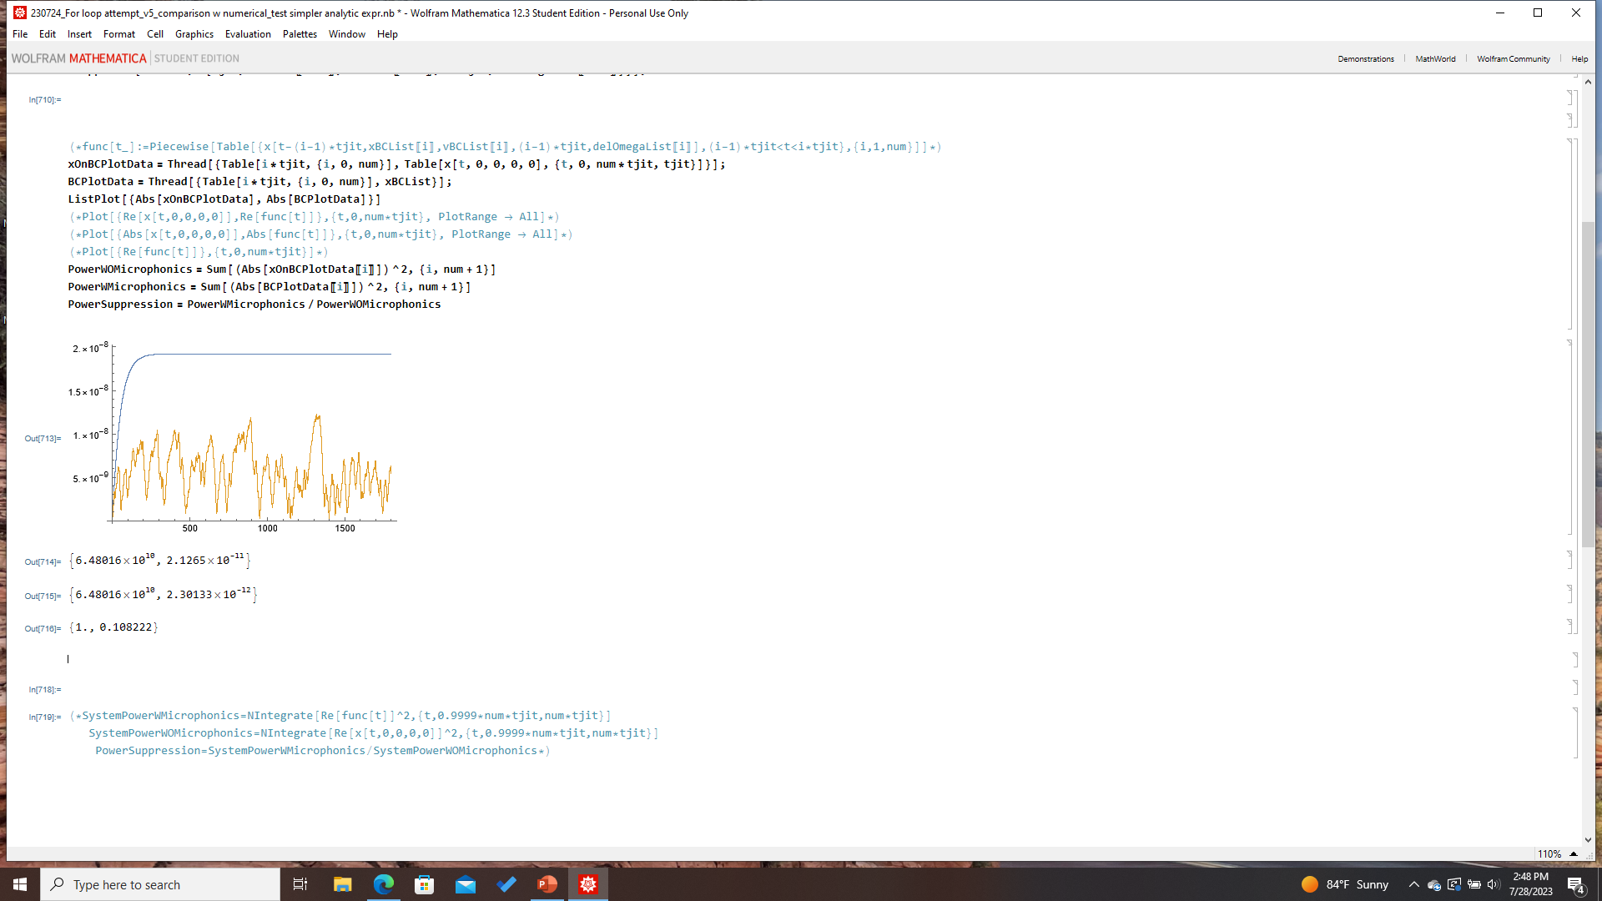
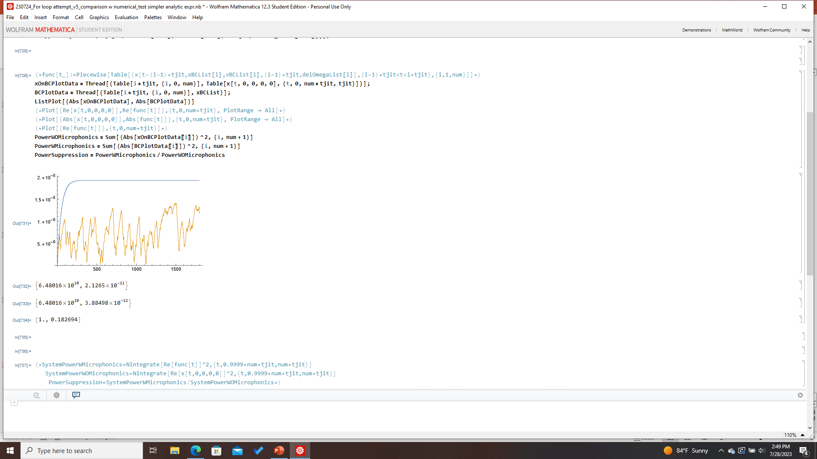
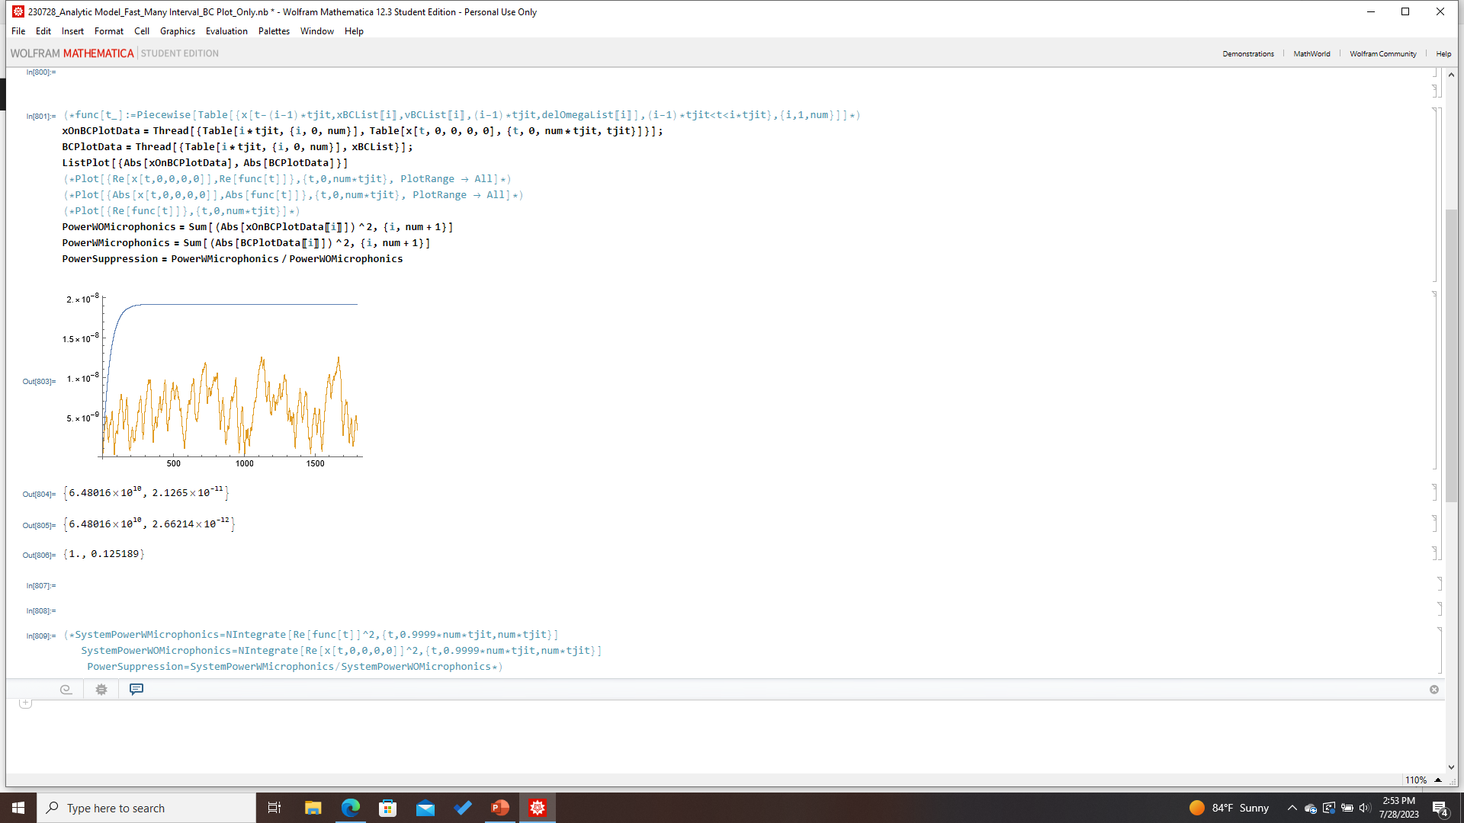

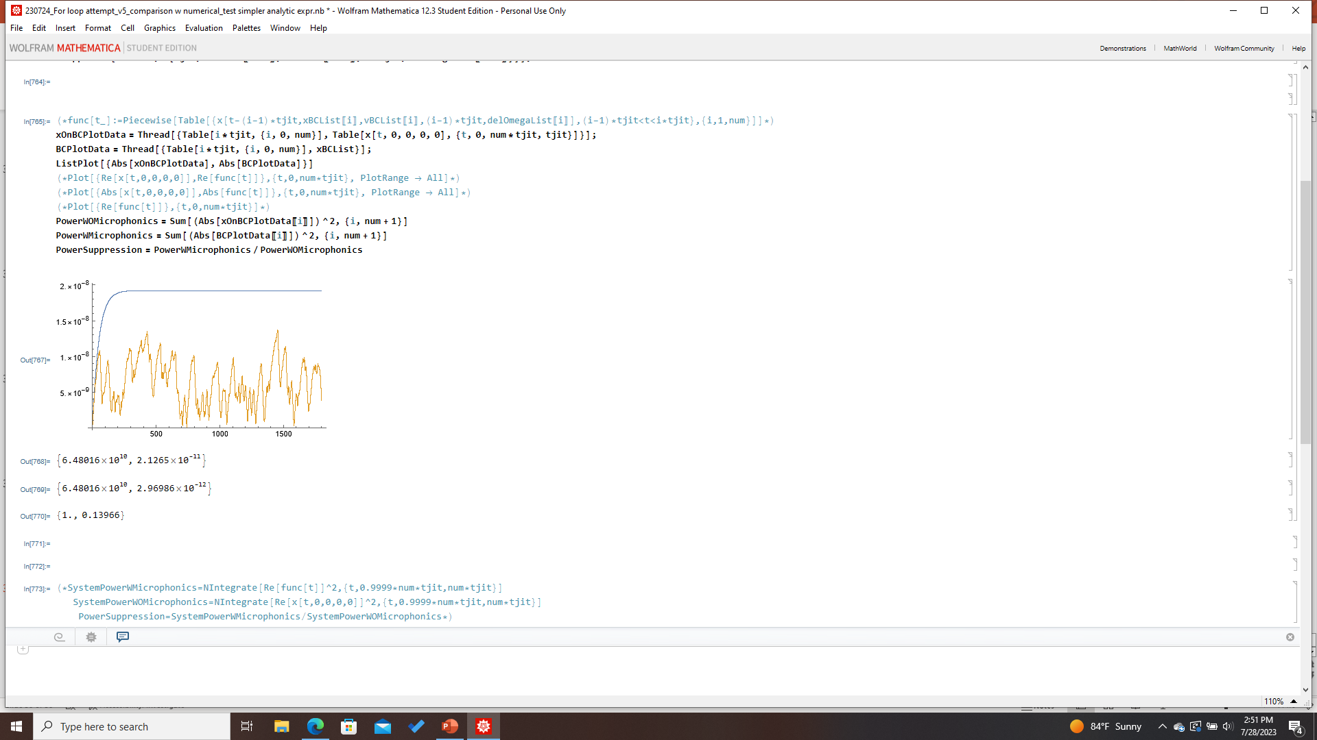
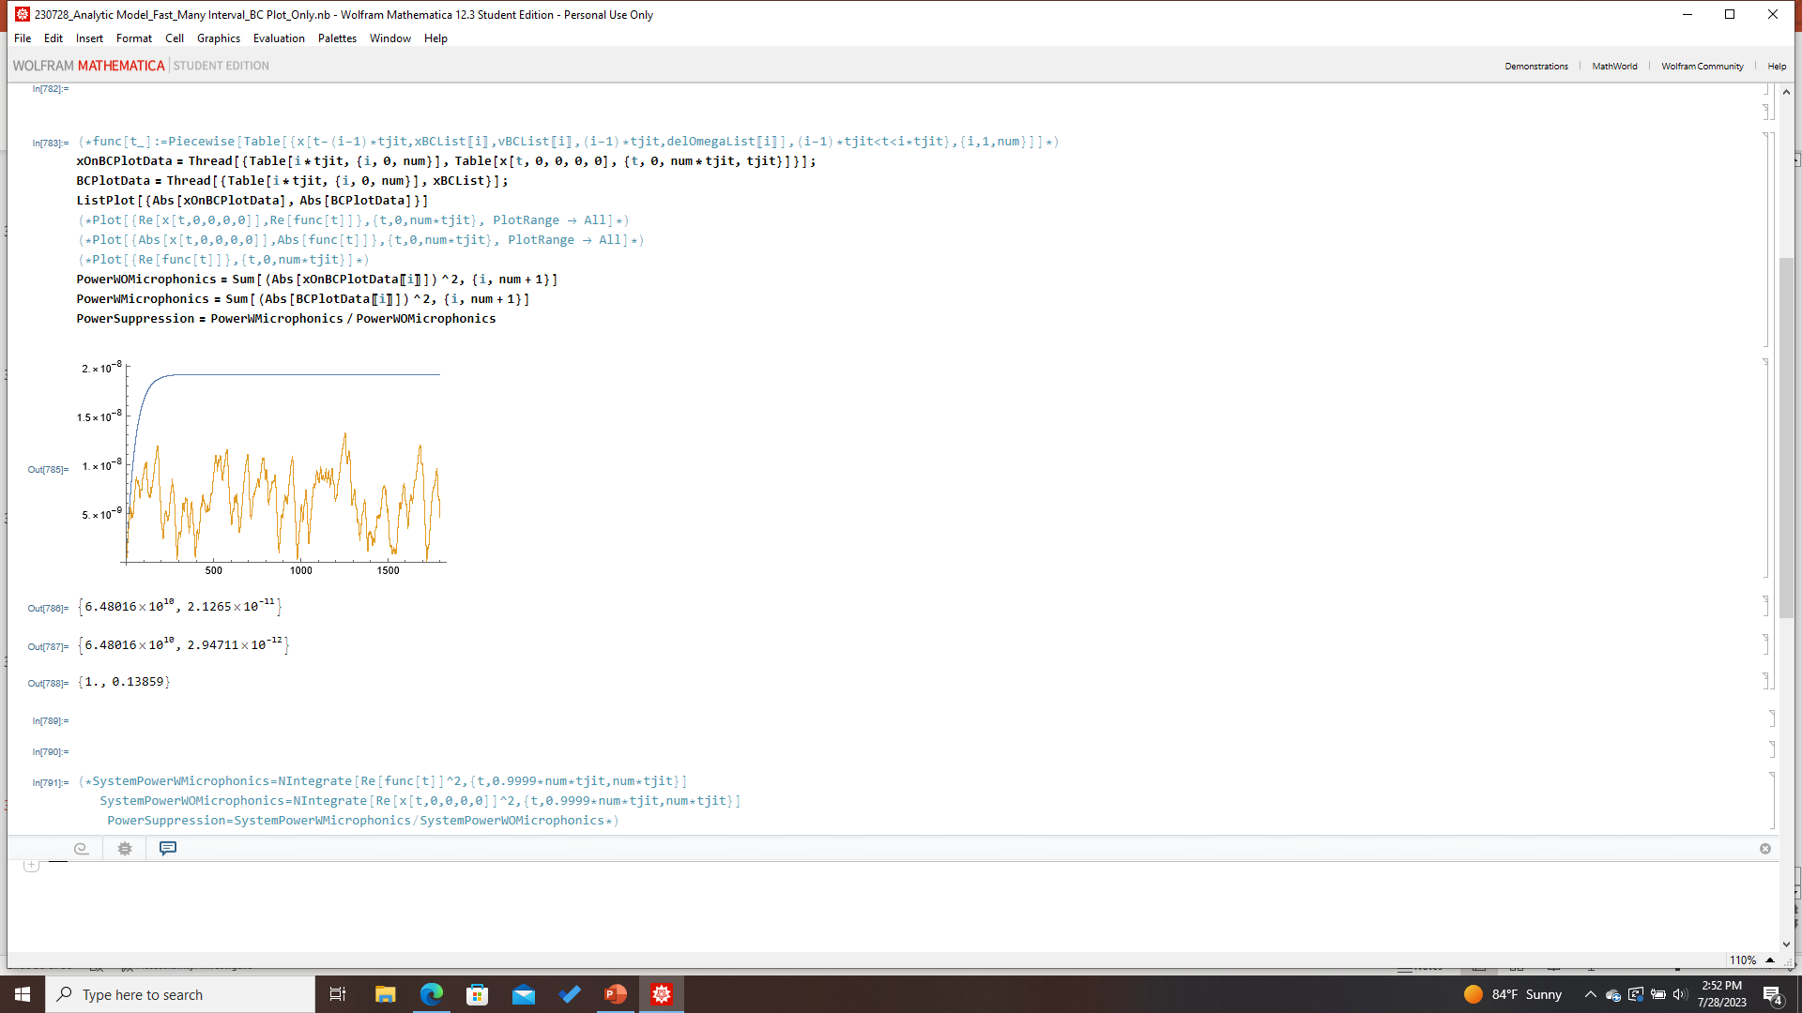
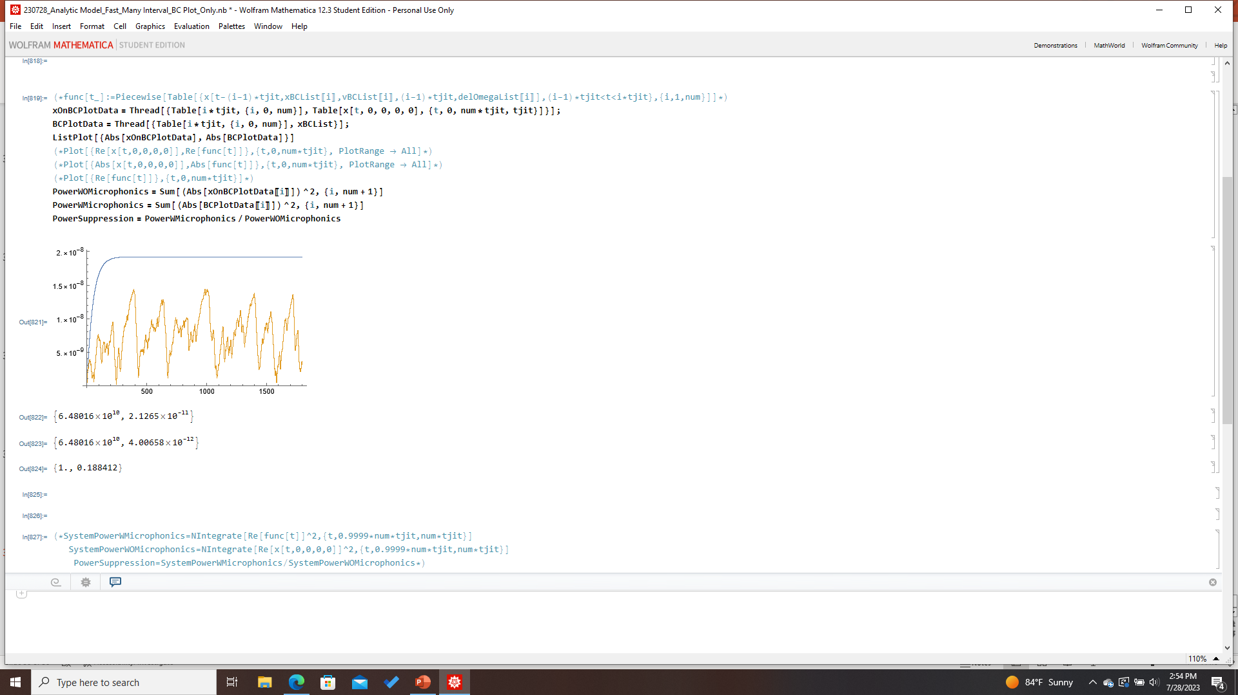
Analytic Physical Model:30 min runs

Slide 3


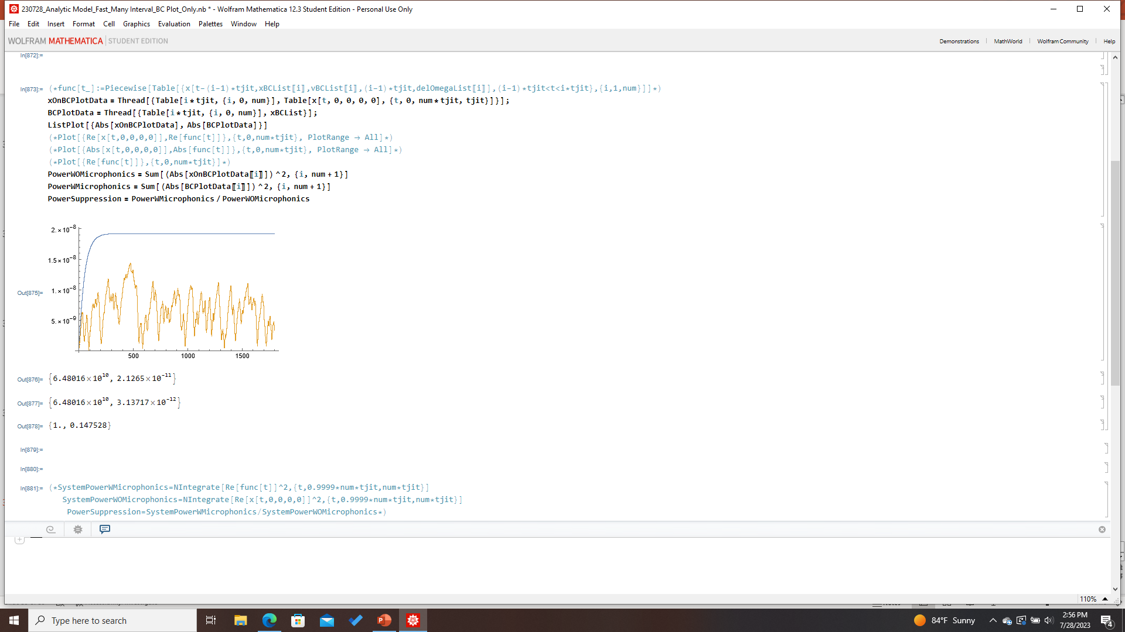




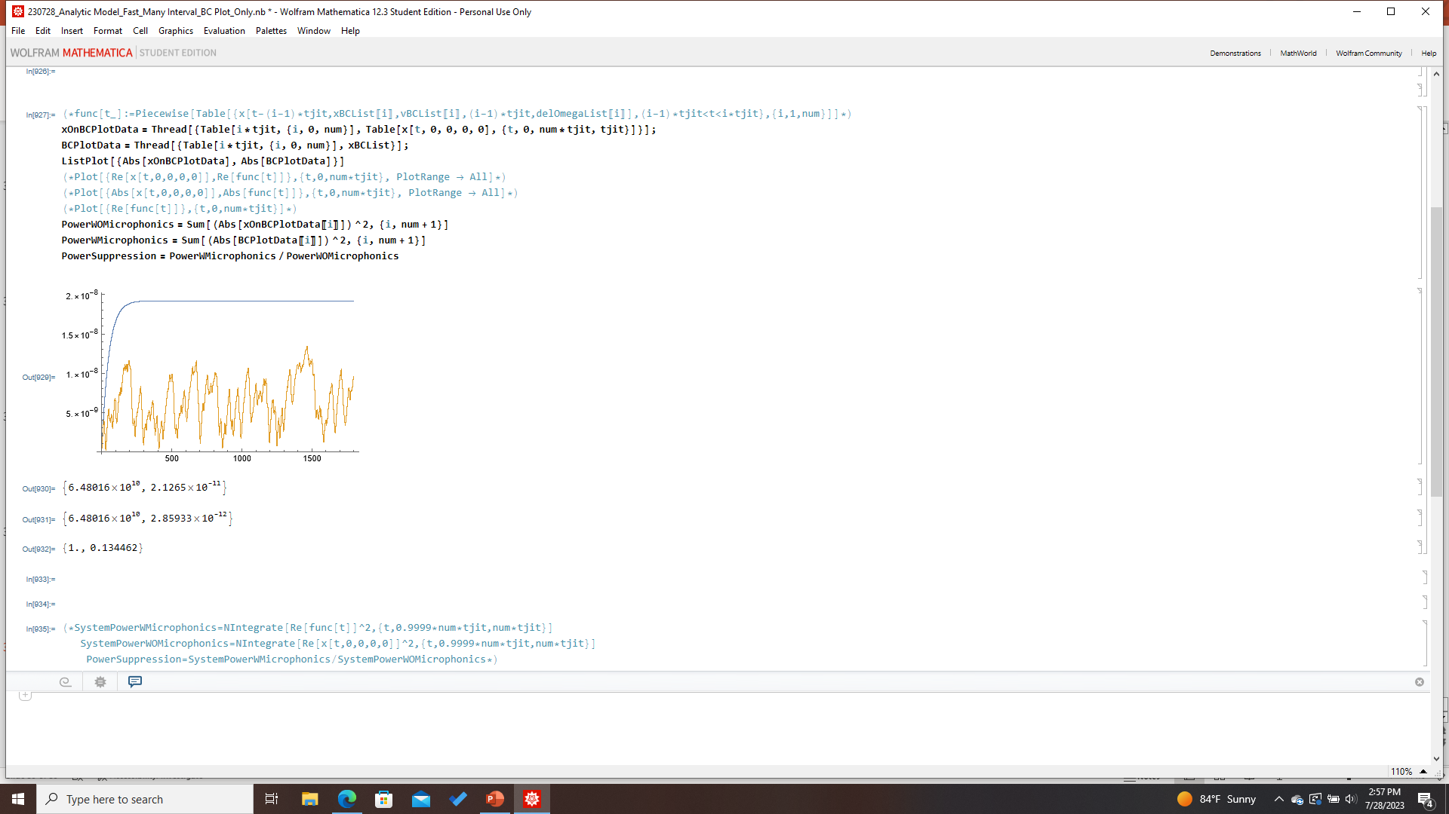




Analytic Physical Model:30 min runs

Slide 4
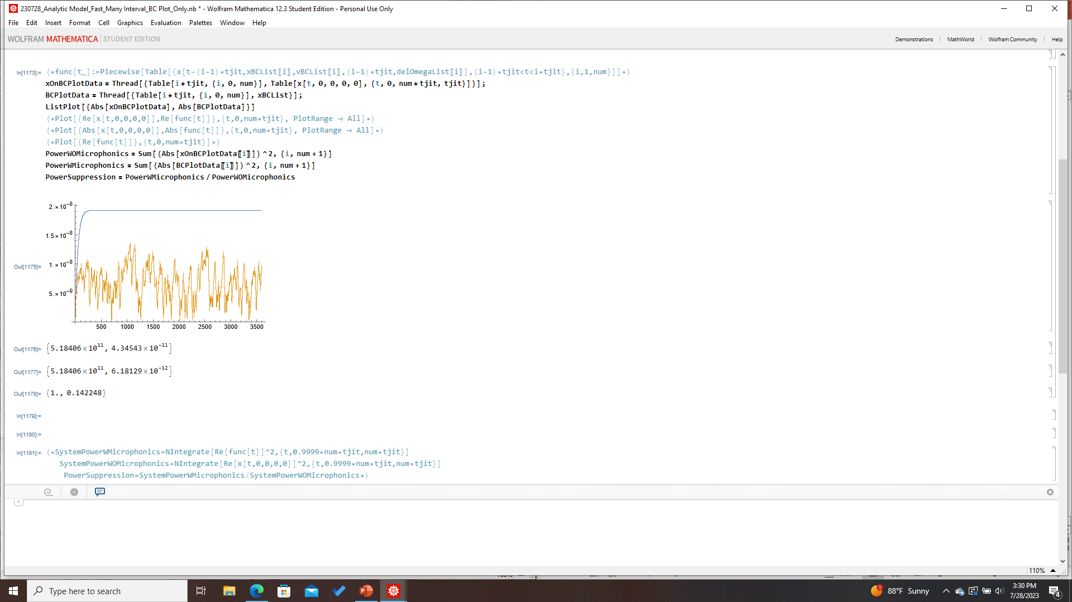

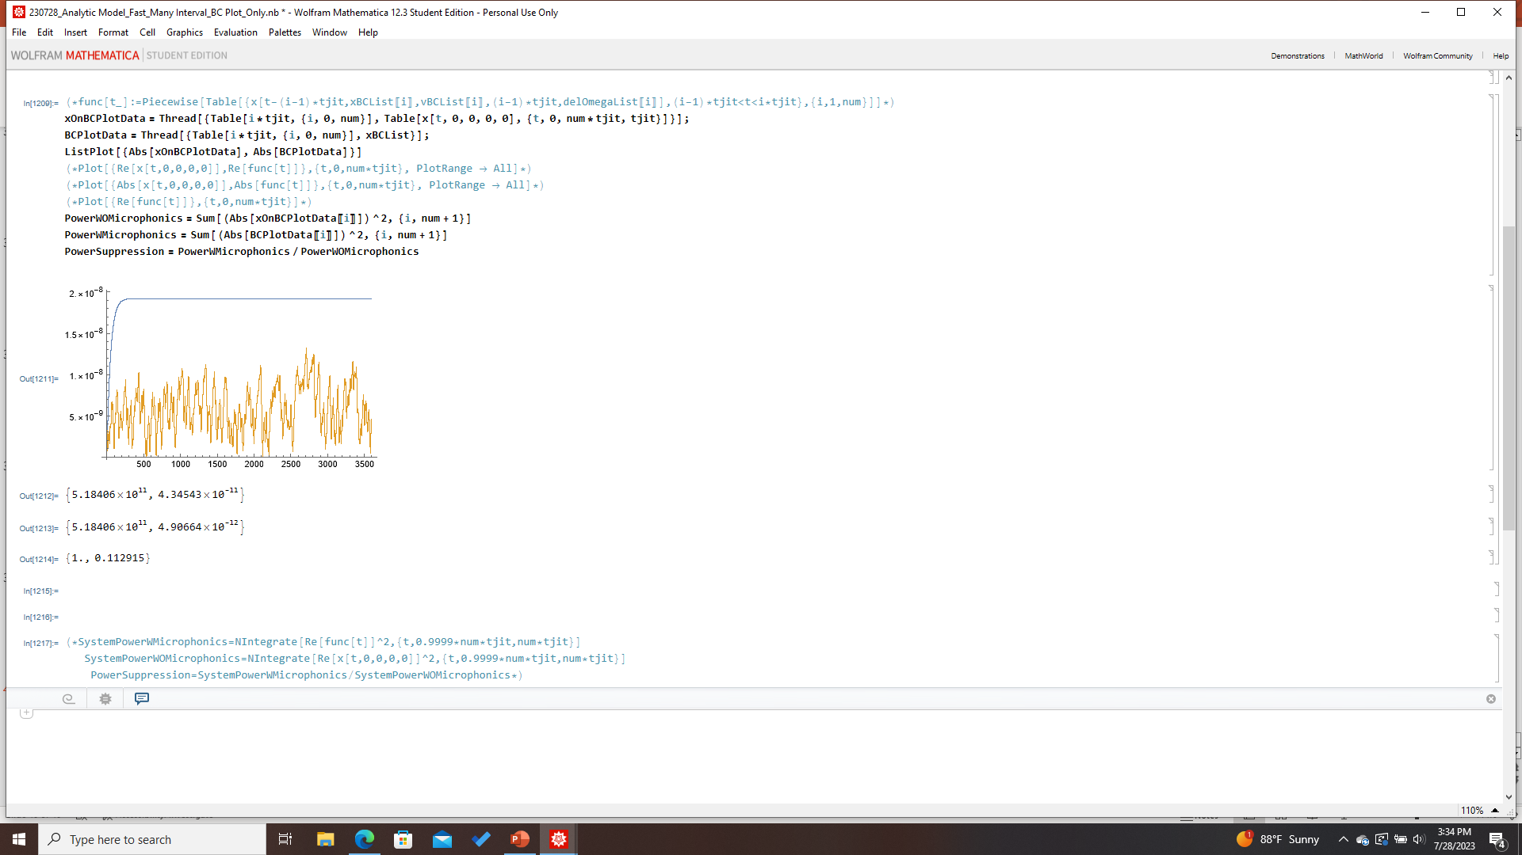
Analytic Physical Model (1 hr runs)

Slide 5
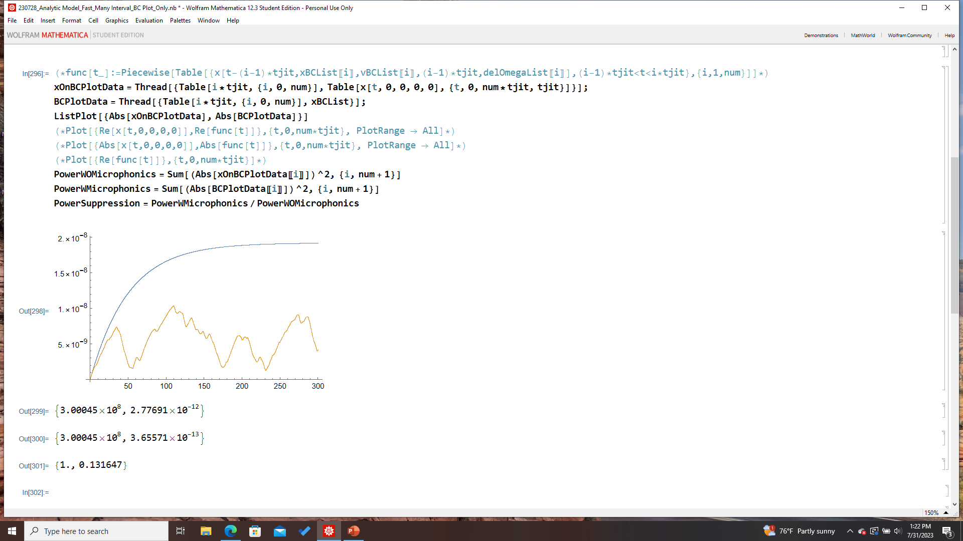
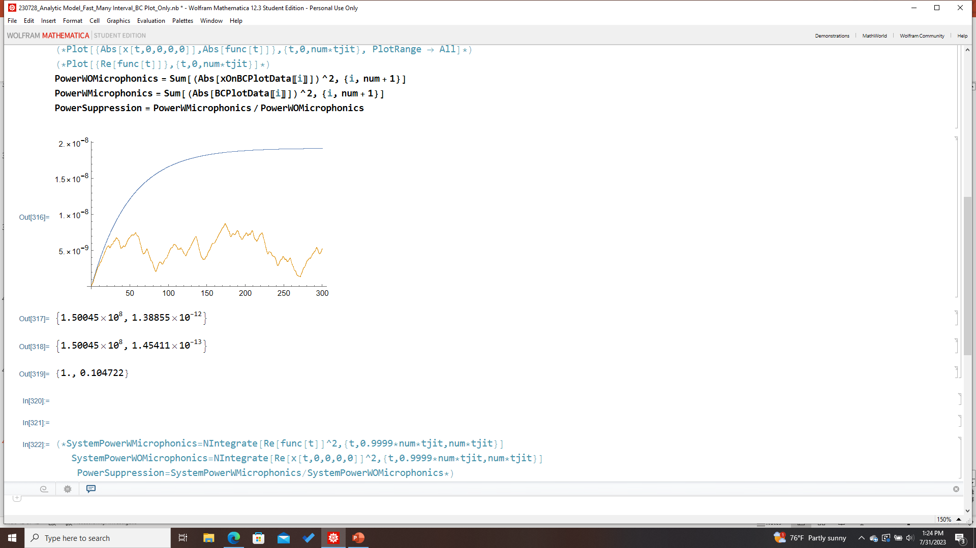
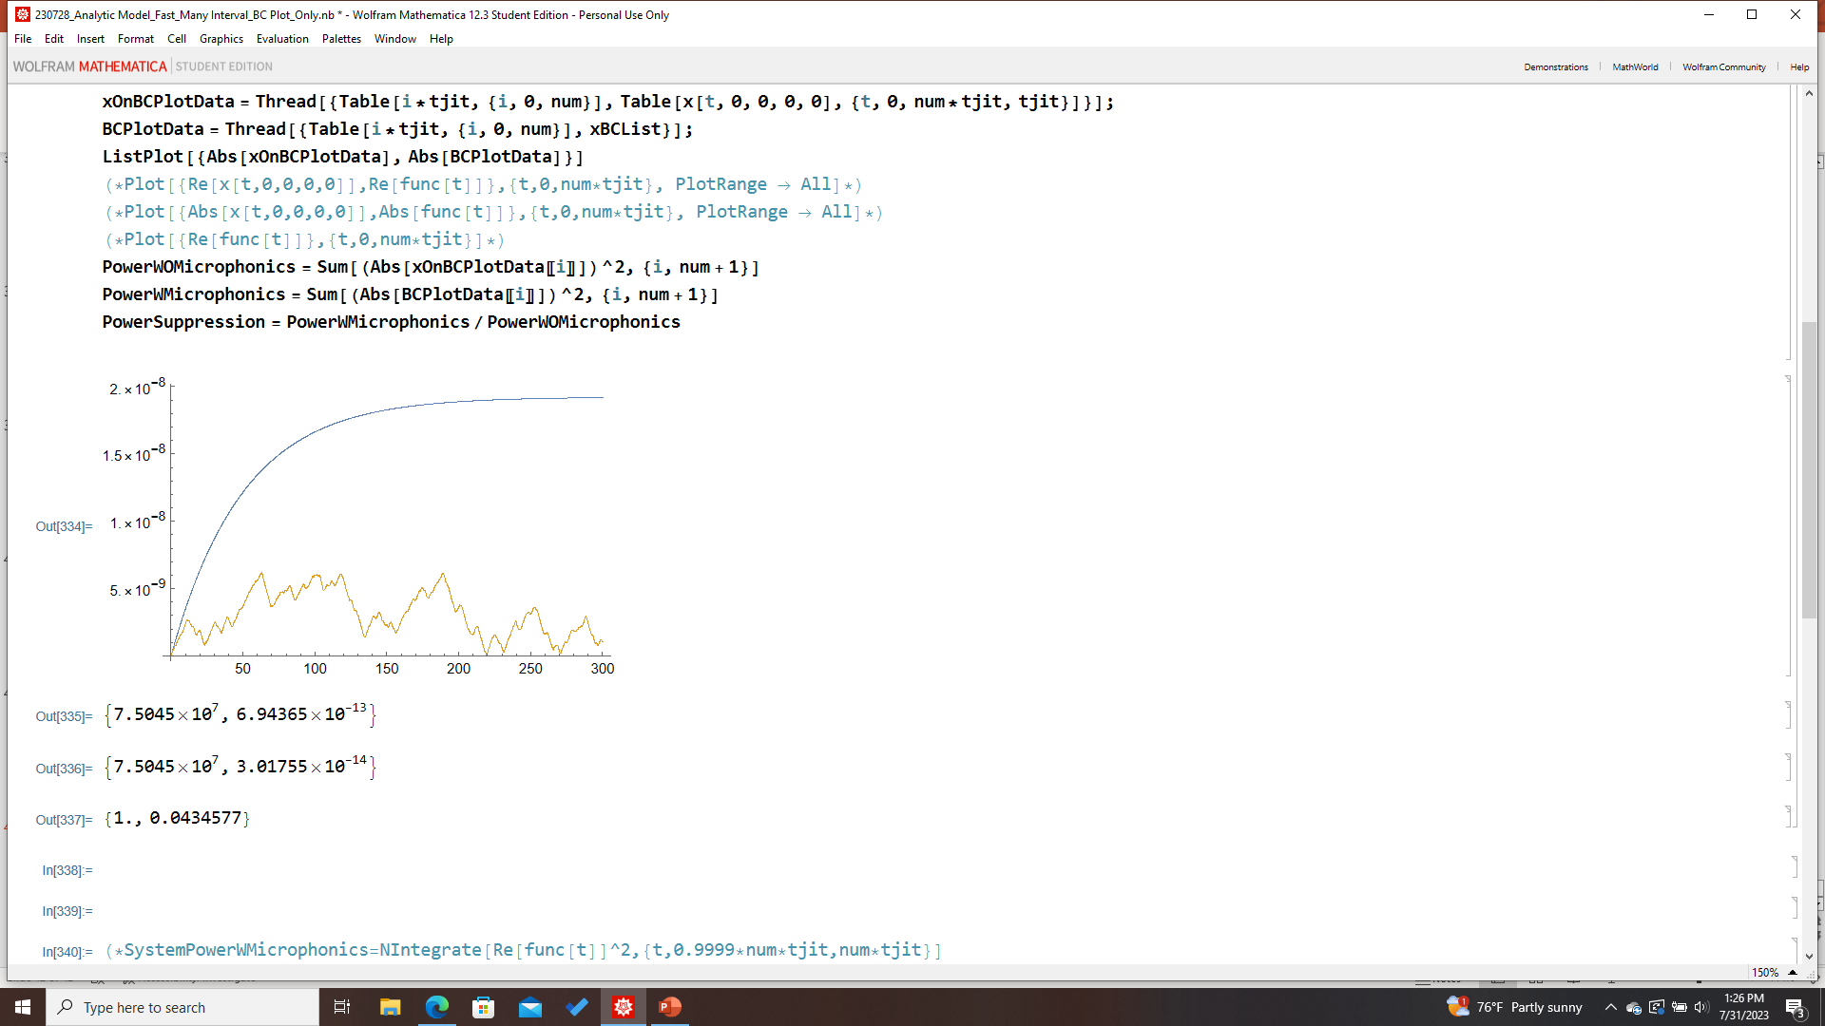
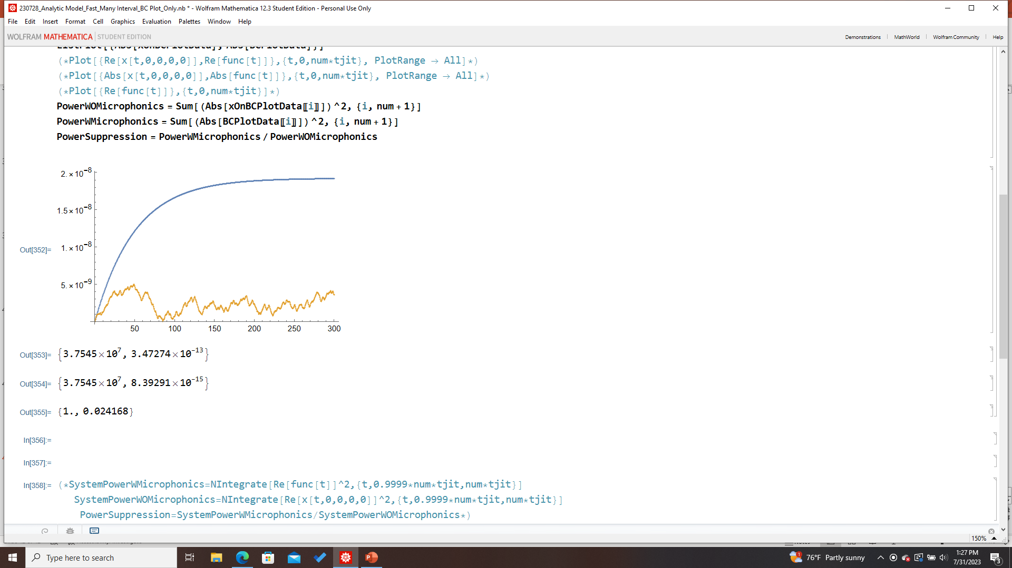
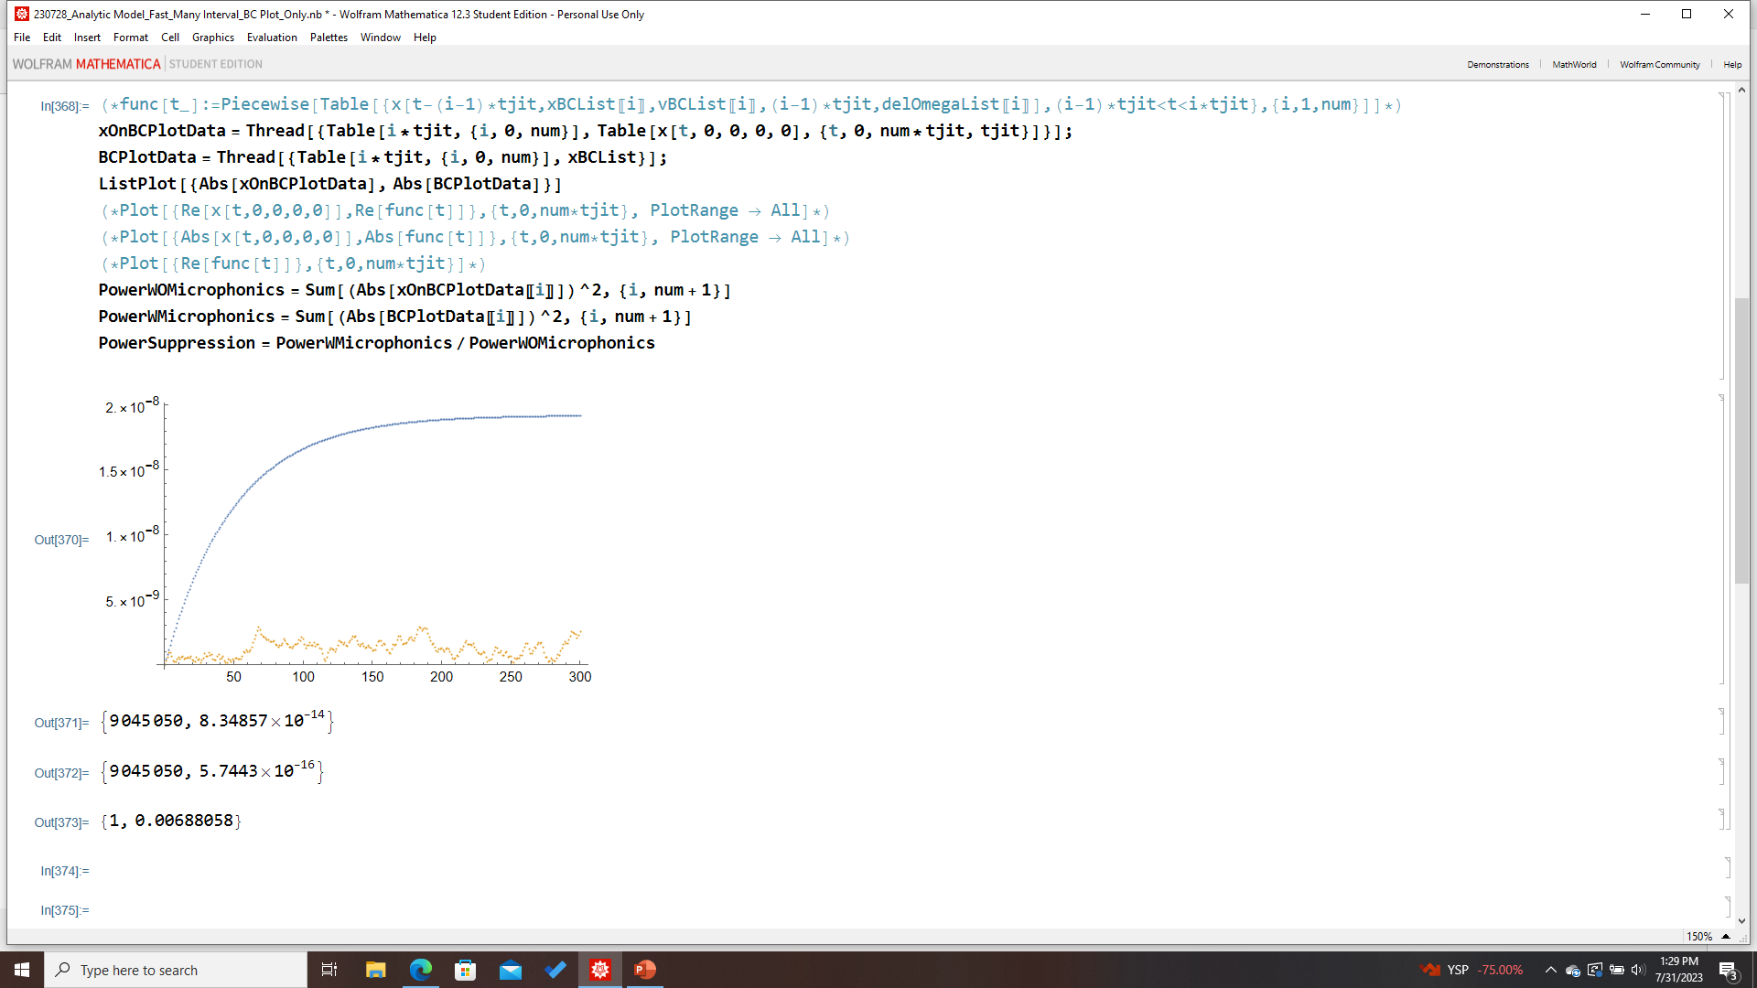
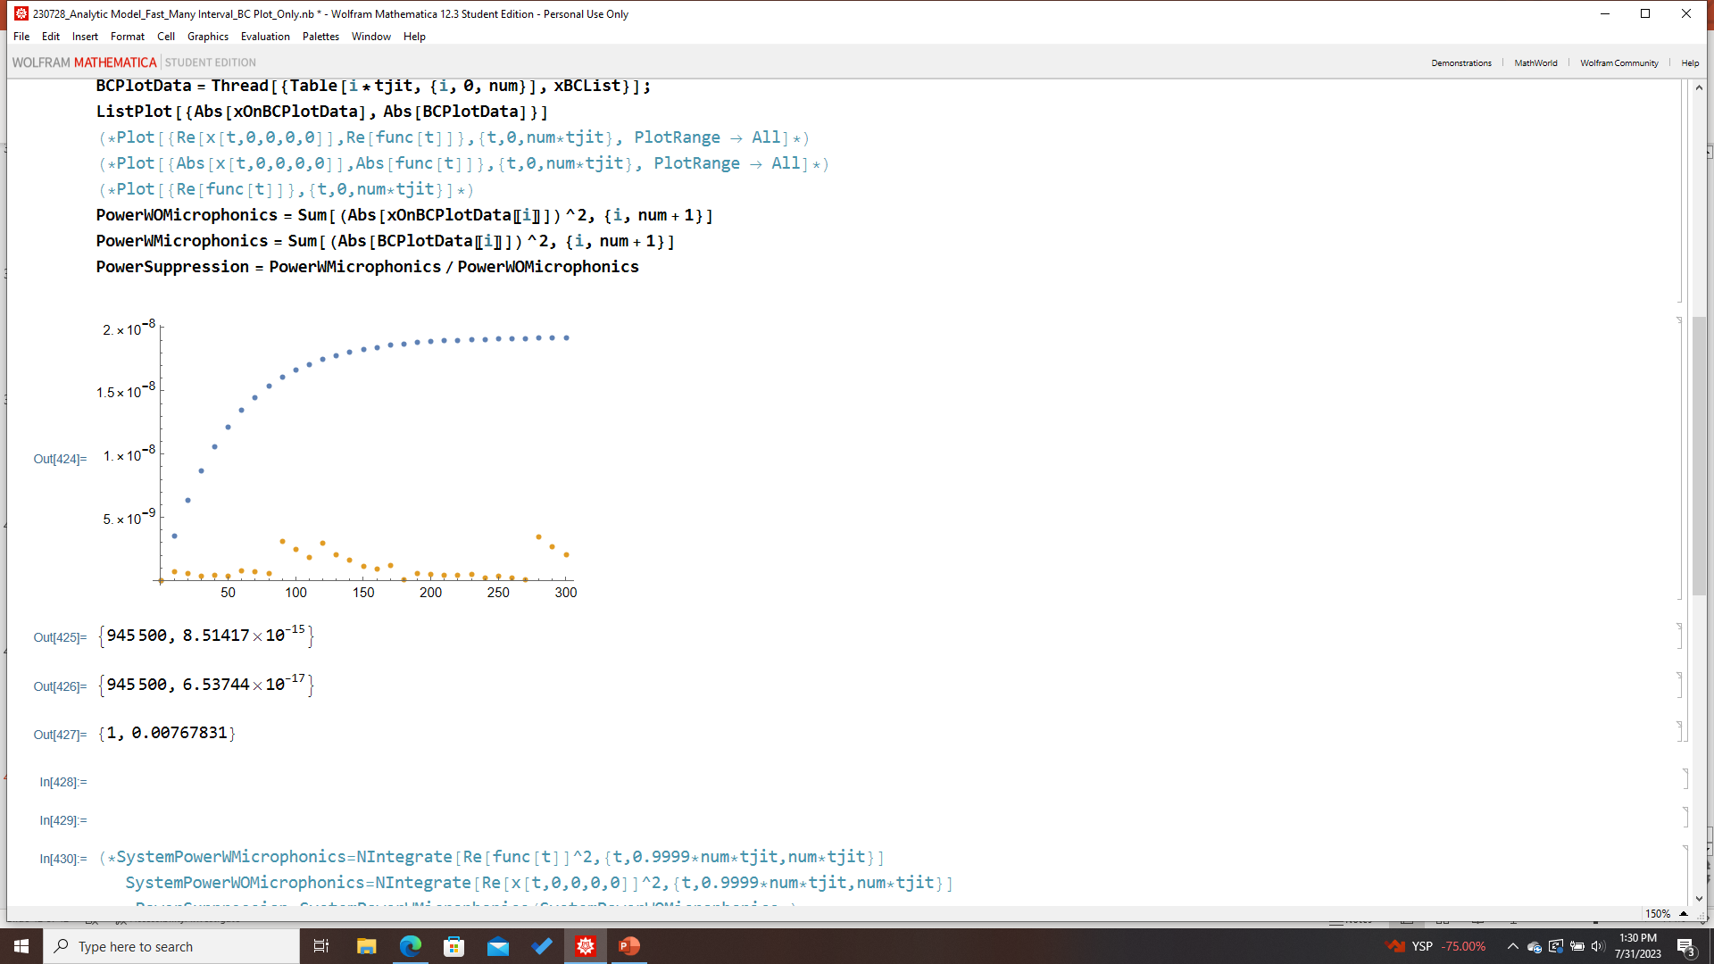
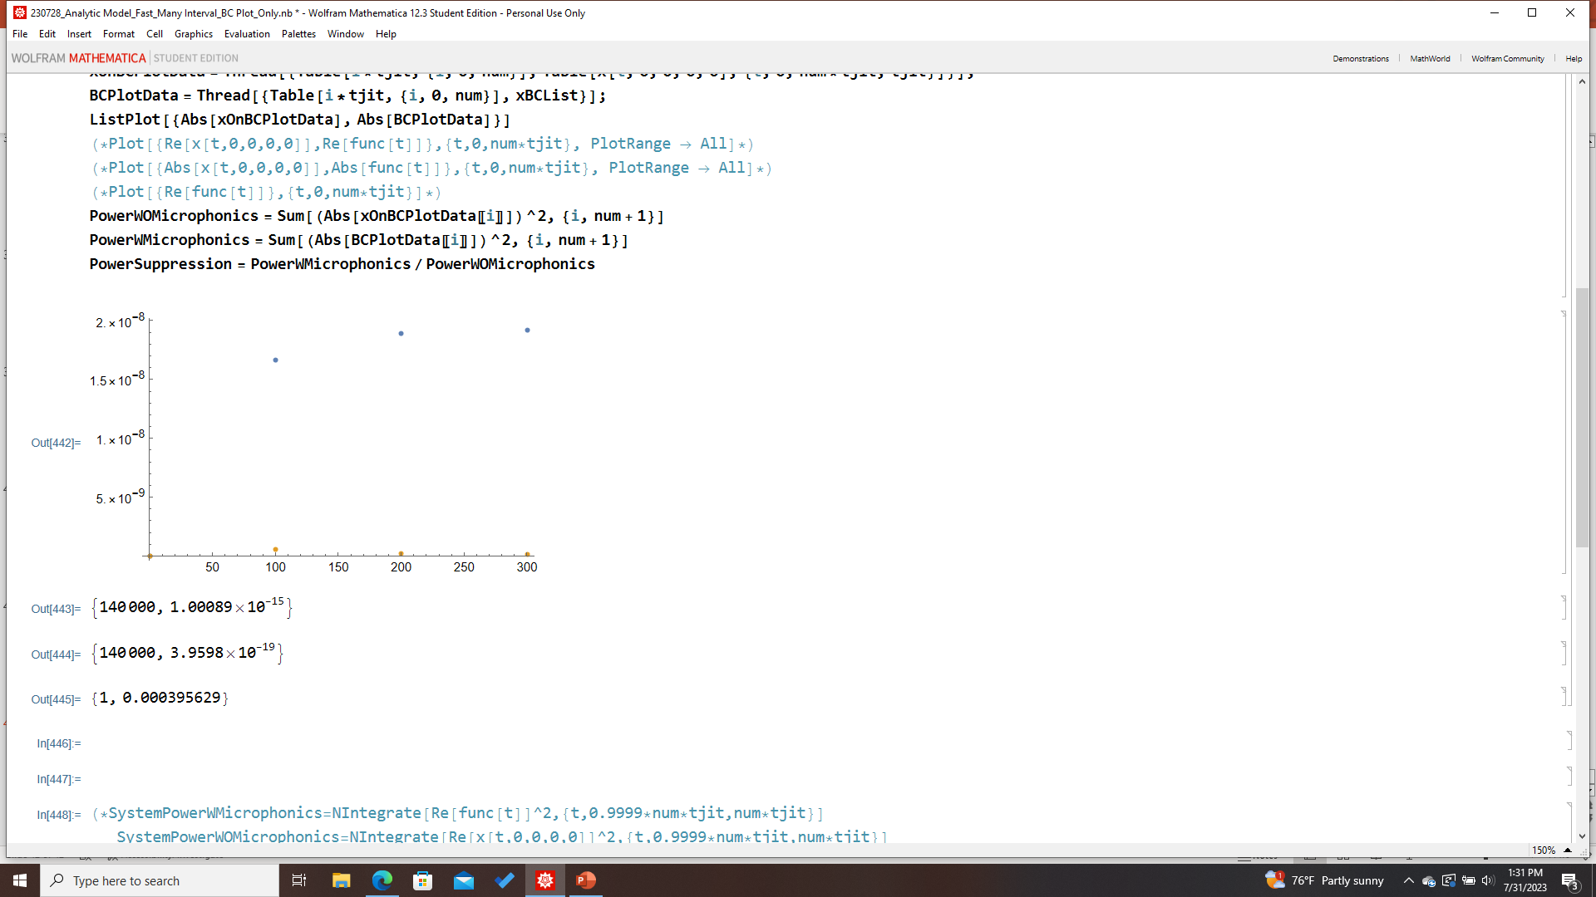
Tjit-Dependence (5 min runs); Rand[NormDist[0,3]]
Tjit= 0.12
Tjit= 0.03
Tjit= 0.06
Power Suppression
Tjit= 0.24
Tjit= 1
Tjit= 100
Tjit= 10
Power Suppression

Slide 6
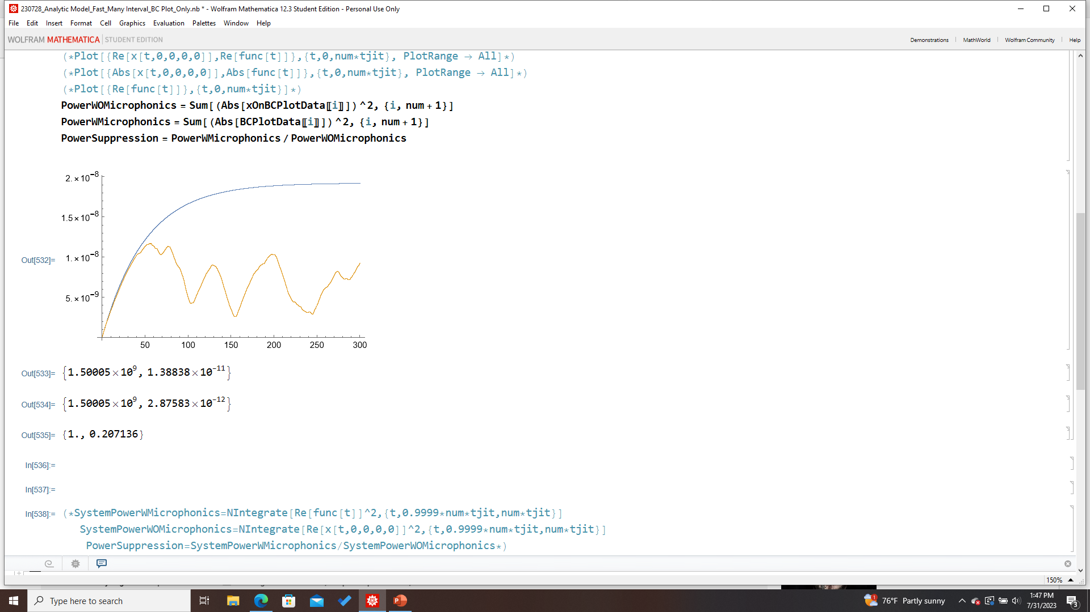

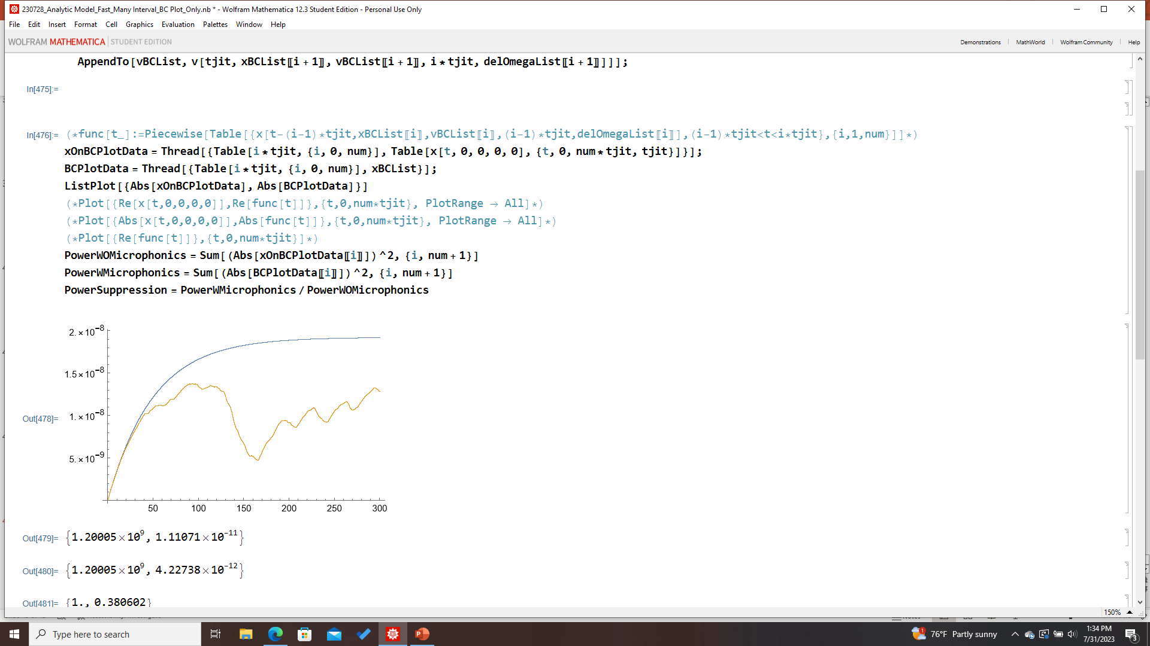
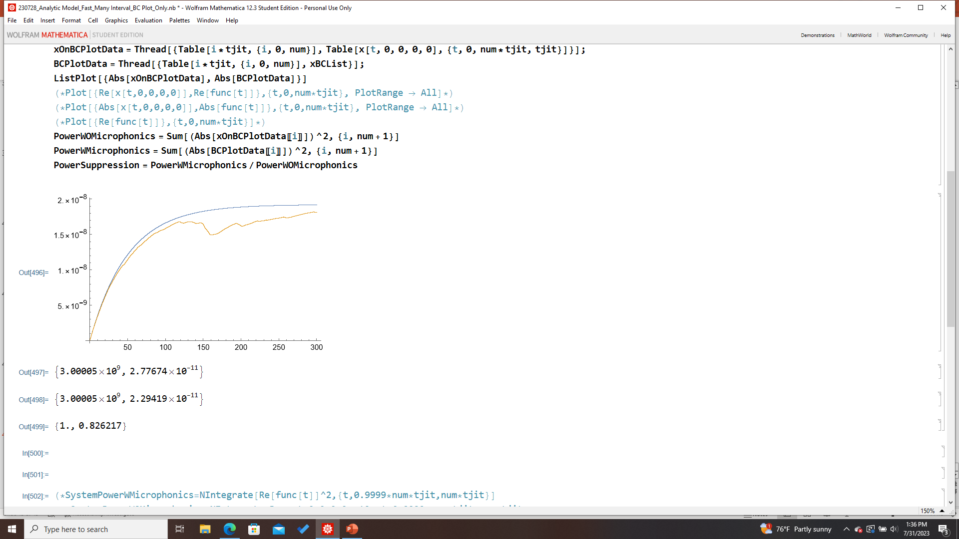
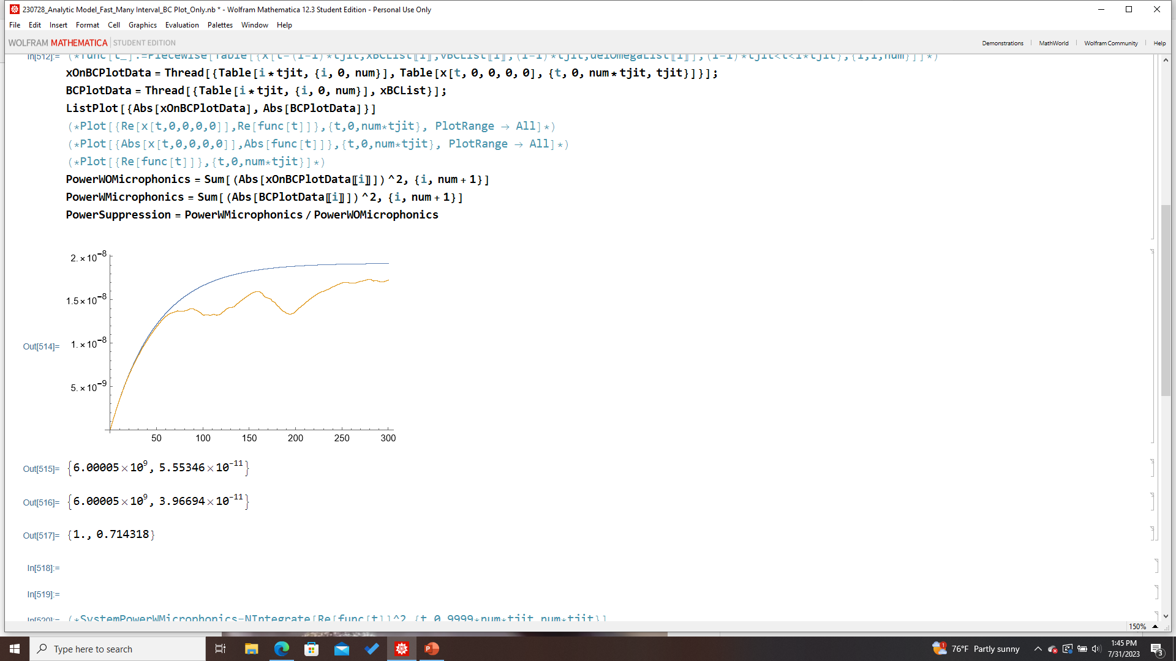
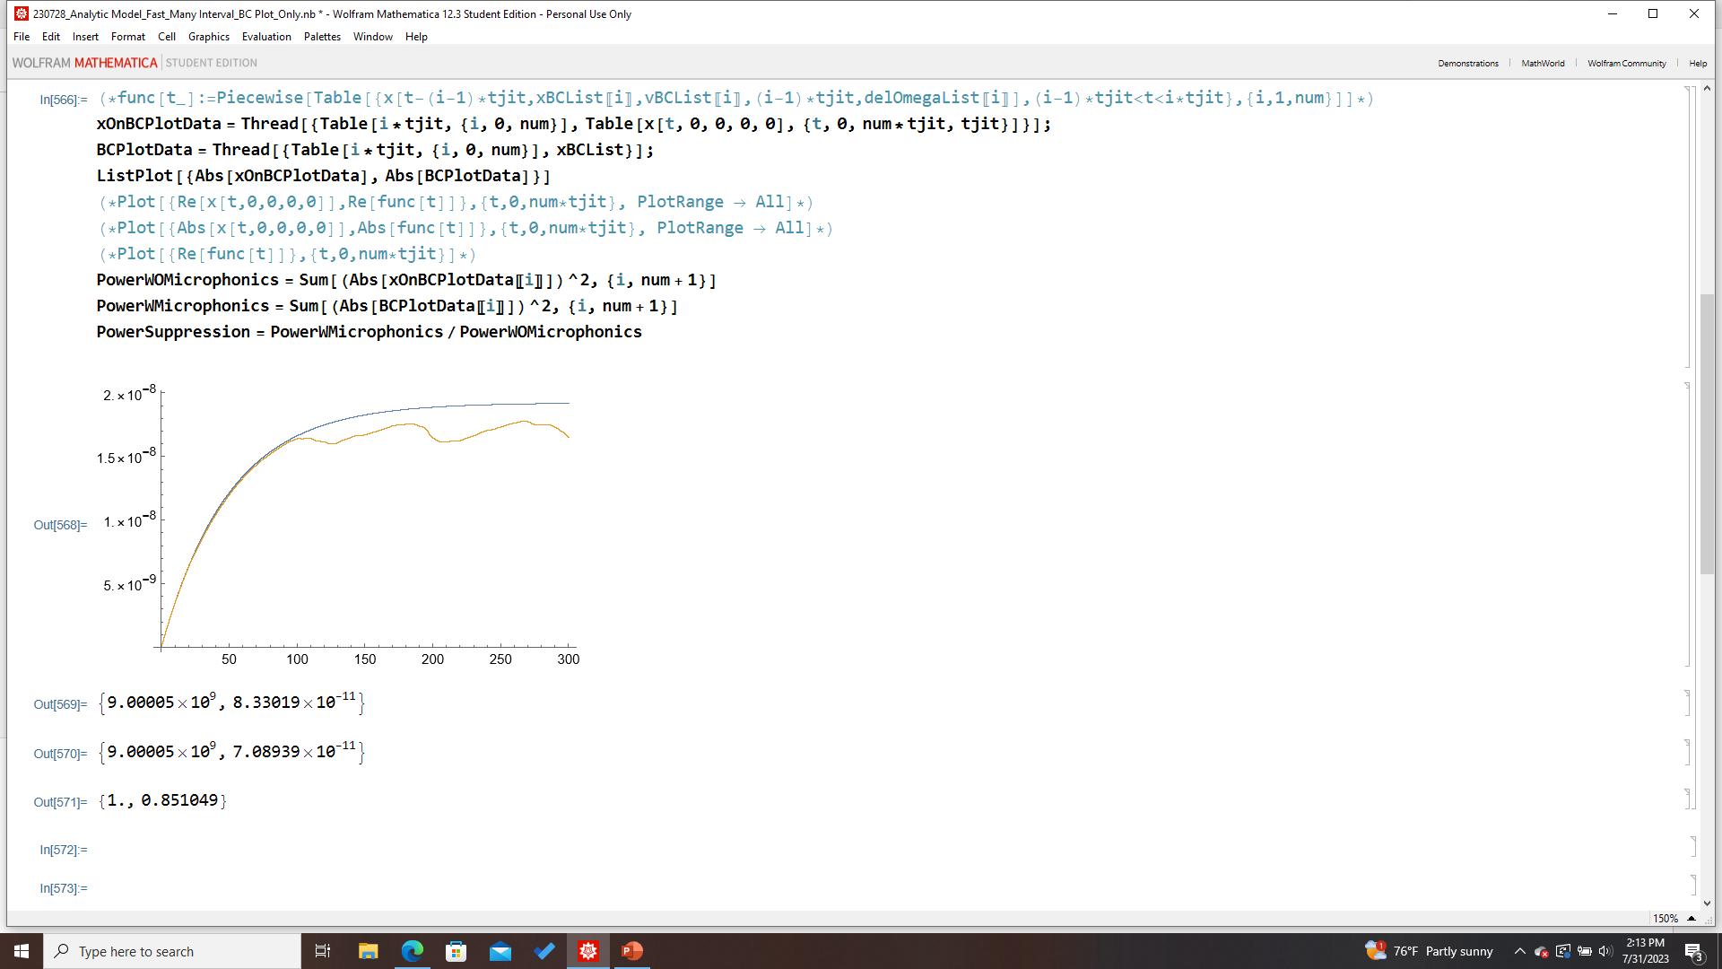
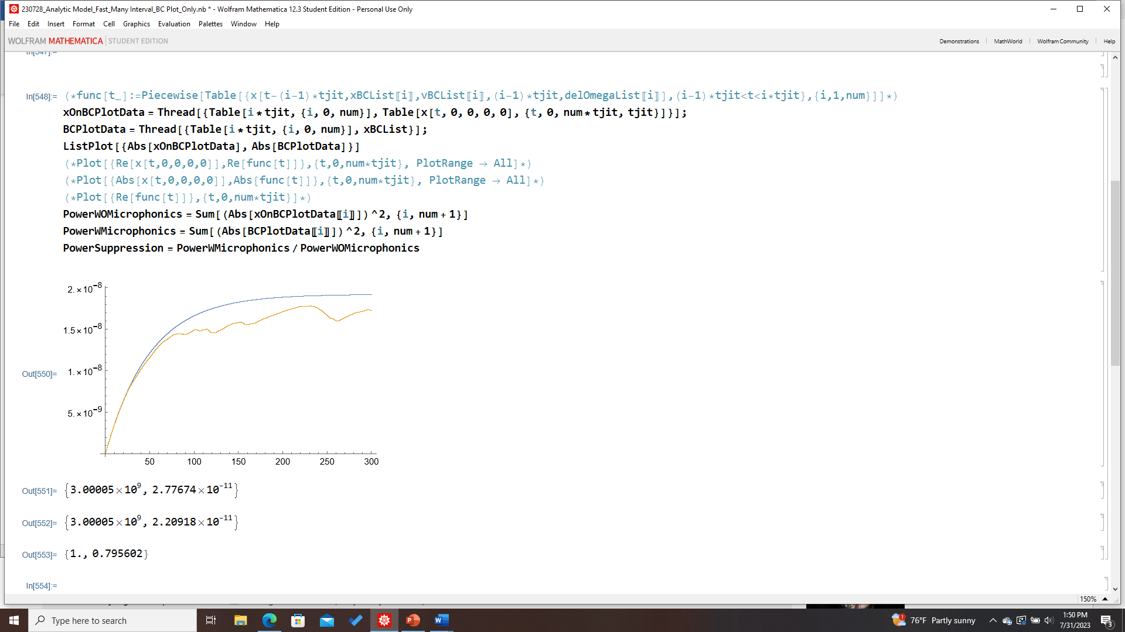
Tjit-Dependence (5 min runs); Rand[NormDist[0,3]]
Tjit= 0.006
Tjit= 0.03
Tjit= 0.015
Tjit= 0.0075
Power Suppression
Tjit= 0.003
Tjit= 0.0015
Tjit= 0.001
Power Suppression
Tjit= 0.003
(Trial 2)

Slide 7
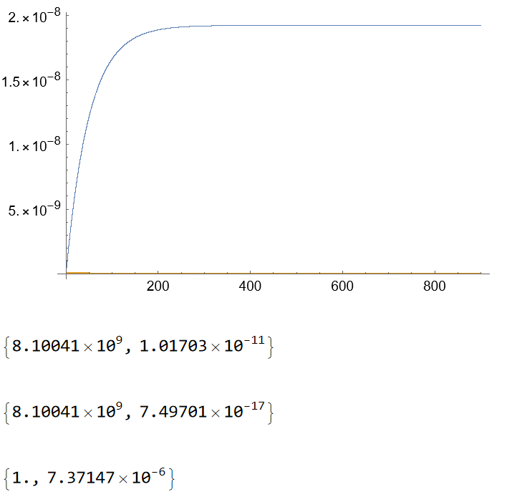
Fixed Offset– Power Suppression

Slide 8
Verify scaling of power suppression w/
delOmega/(omega0/Q)
Capture relative phase in the transient BC component
Re[(x+iv/w)e^(-iw’t)]

